Slide 1
STUDENT DISCUSSION FORUM
Team-9
Sagnik(Mentor)
G Vishnu Priya
Supriya
Sathvika
Abhigna
Subramani
Shreya
Meghana
Hrudaya

Slide 2
Problem statement
Student discussion forum on projects and other technical stuff.

Slide 3
What is student discussion forum?
An online discussion board provides the ability for asynchronous discussions to occur over a period of time. Students are able to gather their thoughts and ideas before posting and sharing their reflective responses, which leads to more in-depth learning.

Slide 4
modules
The project has been divided into two modules:
Admin and
user

Slide 5
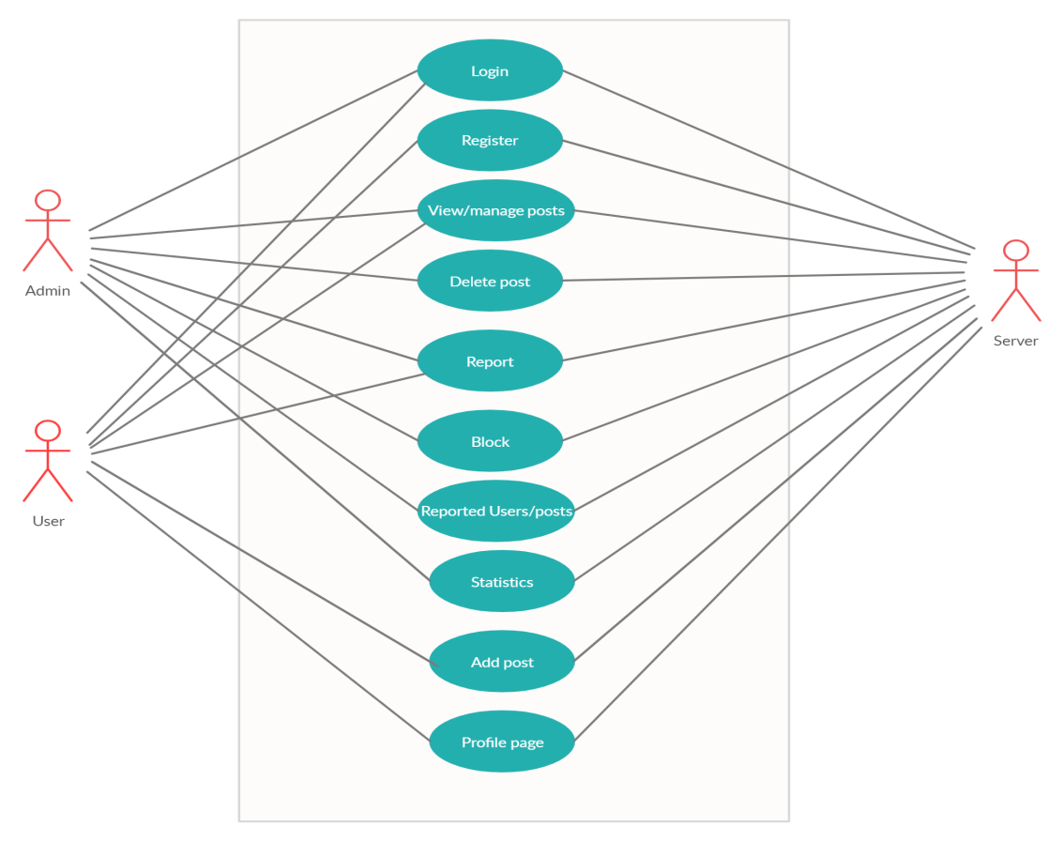

Slide 6
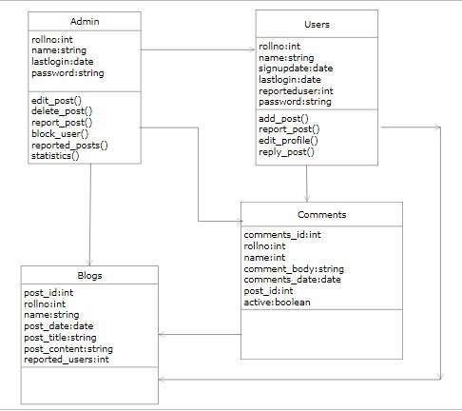
class diagram

Slide 7
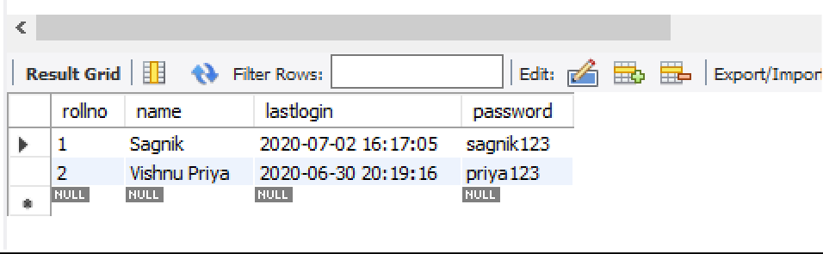
TABLES
Admin:

Slide 8
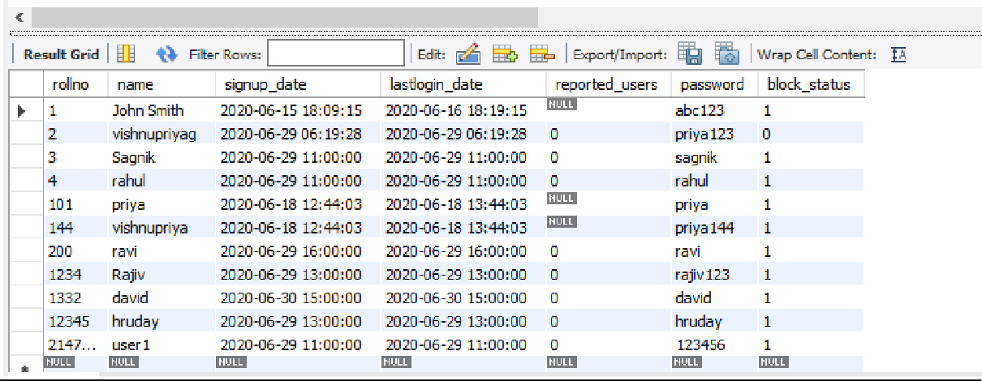
User:

Slide 9
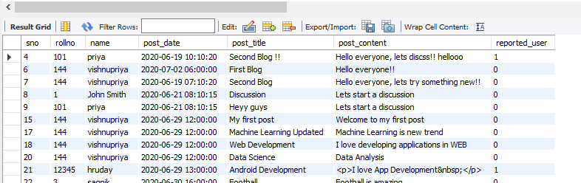
Blogs:

Slide 10
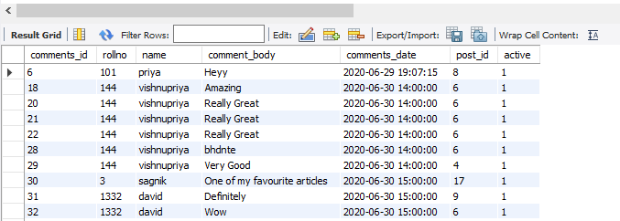
Comments:

Slide 11
Admin
View and manage posts.
Section for reported users.
Block a user.
Delete a post.
Statistics

Slide 12
user
In user we have:
Login Screen linked to the database.
Home Screen with all the posts.
An option to reply to the posts.
An option to search posts.
Add a new post.
Profile page to view and manage the user’s posts.
An option to report users/posts.

Slide 13
TECH STACK
Django
Flask
Boostrap
Android Studio
Django Rest Framework

Slide 14
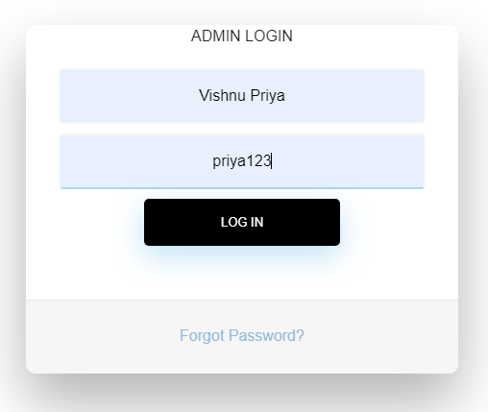
Screenshots of execution

Slide 15
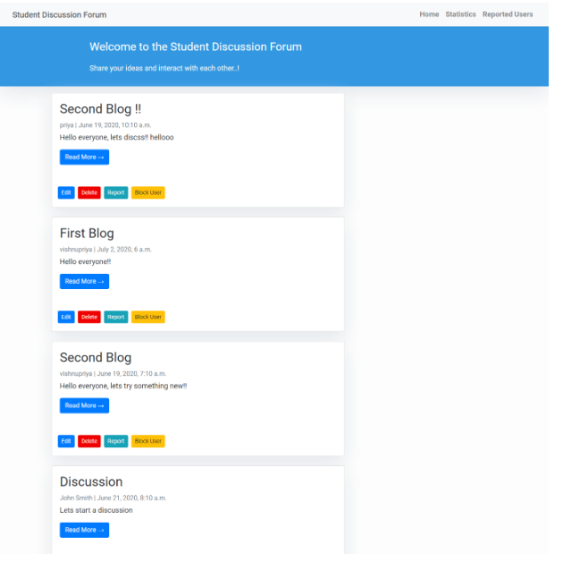

Slide 16
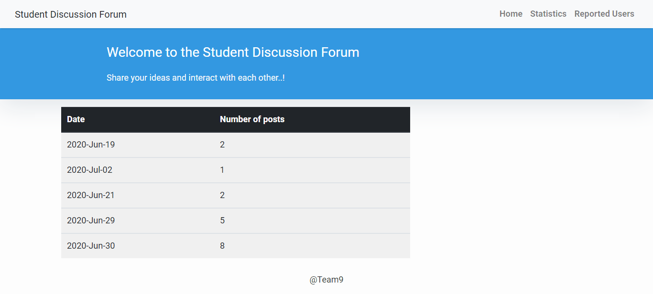
STATISTICS
Number of posted added each day.

Slide 17
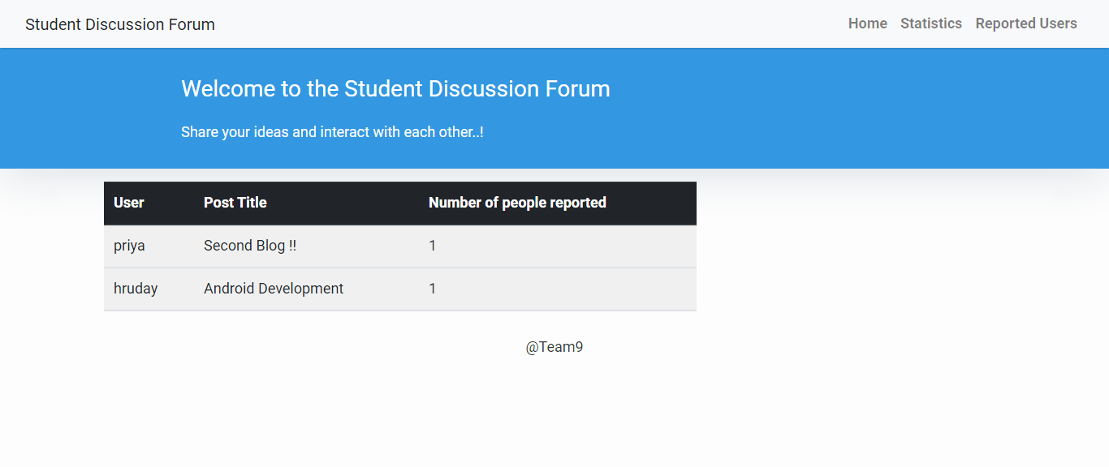
REPORTED USERS

Slide 18
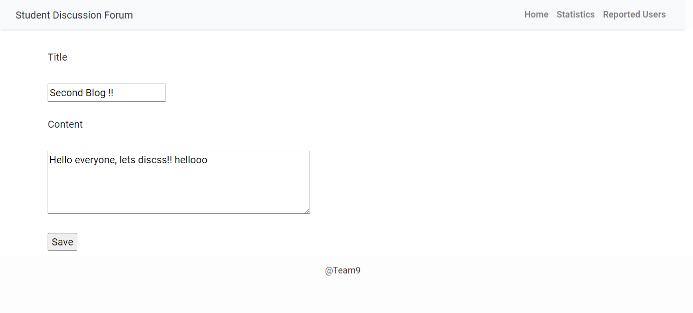
EDIT POST
When a user updates the post, their updated time gets updated in the database.

Slide 19
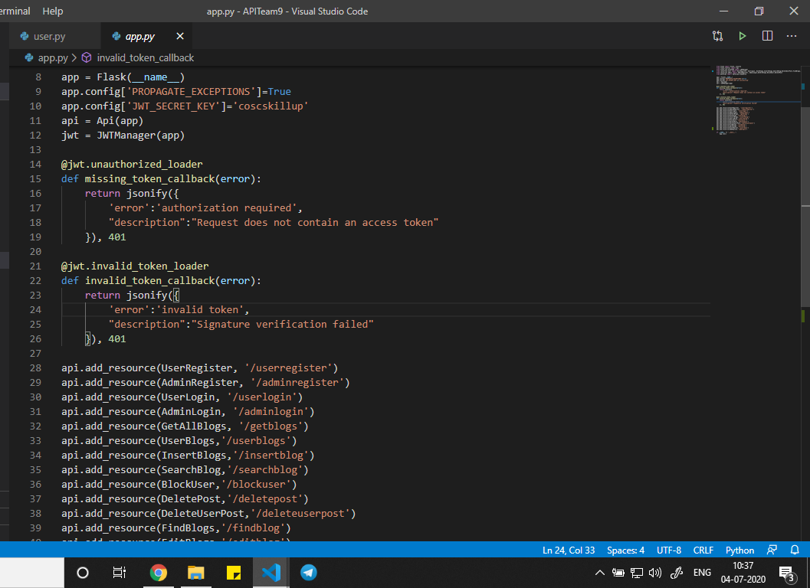
API Calls

Slide 20
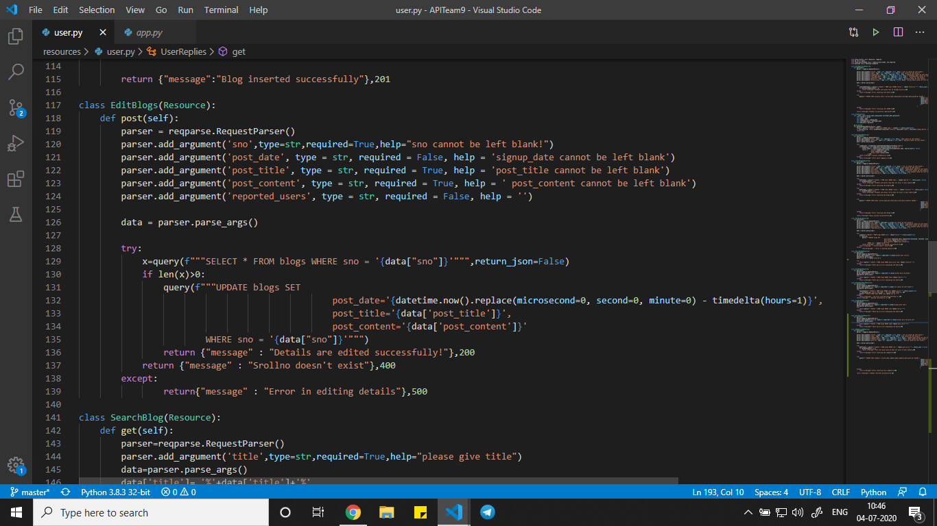

Slide 21
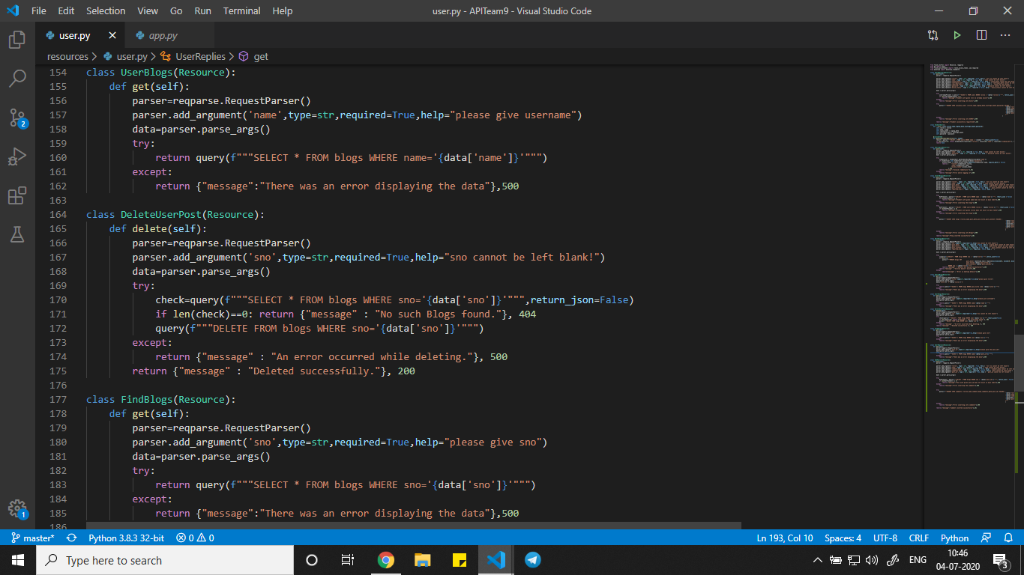

Slide 22
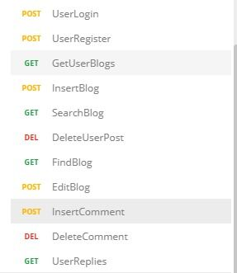
We have created requests in Postman for each functionality and tested them before deploying in Heroku.

Slide 23
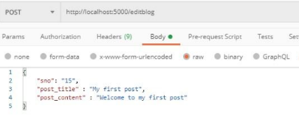
We have tested using postman, this is one of the request we have tested.
This is for edit blog.

Slide 24
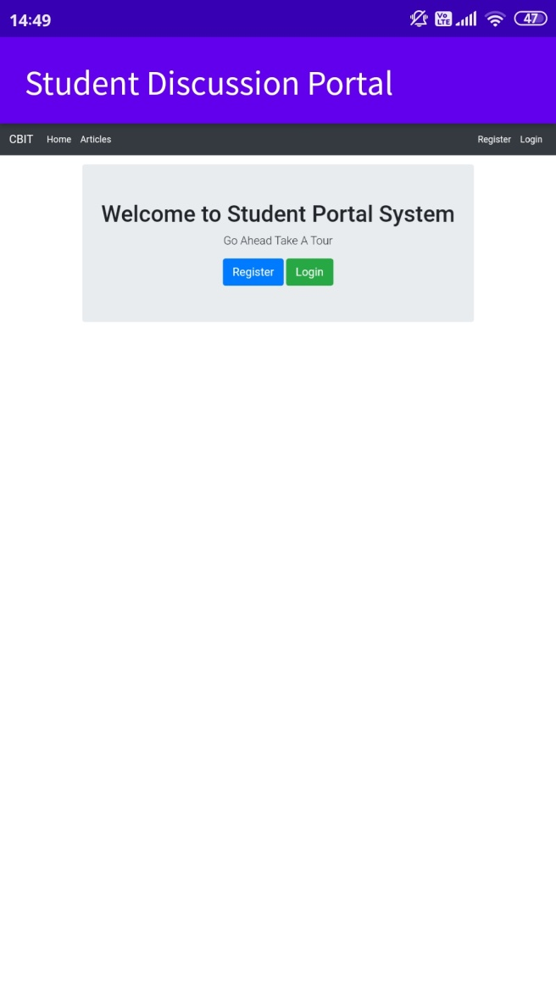
Screenshots of execution

Slide 25
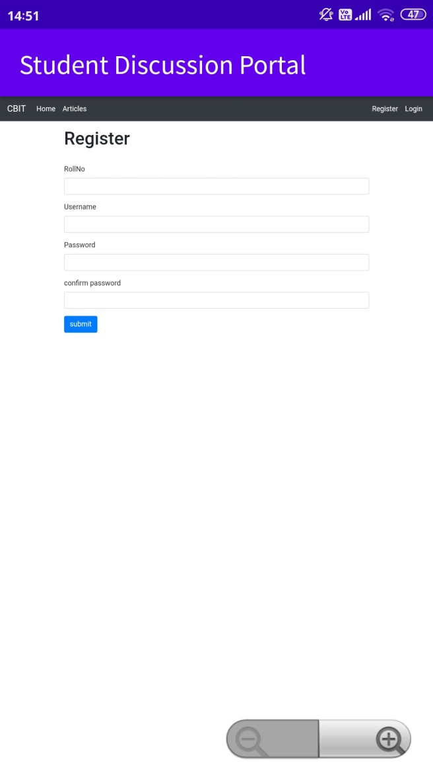

Slide 26
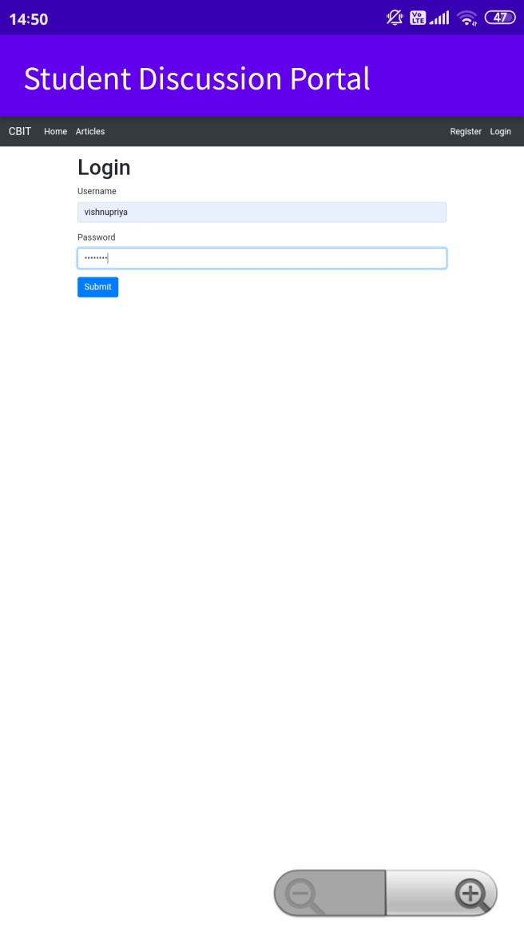

Slide 27
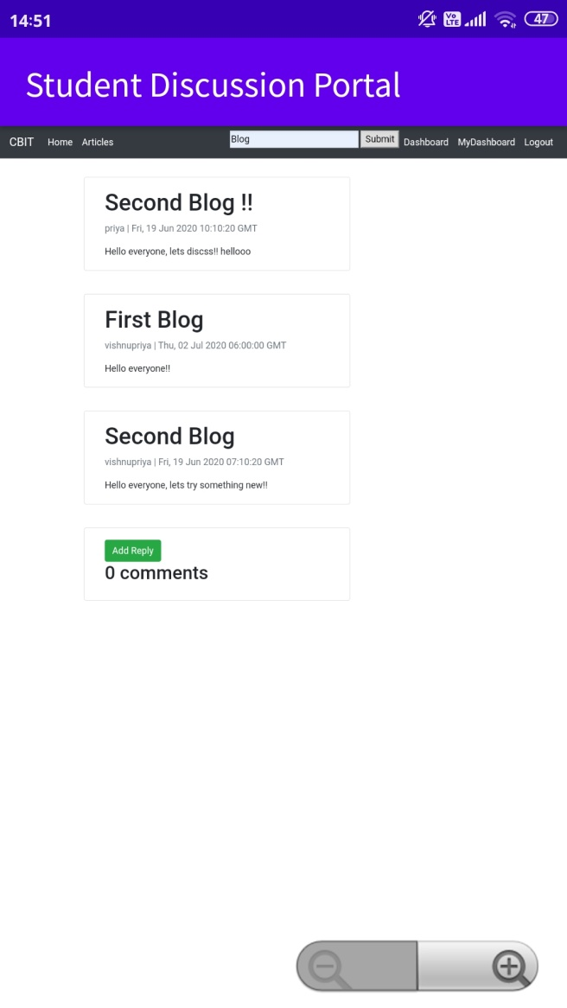

Slide 28
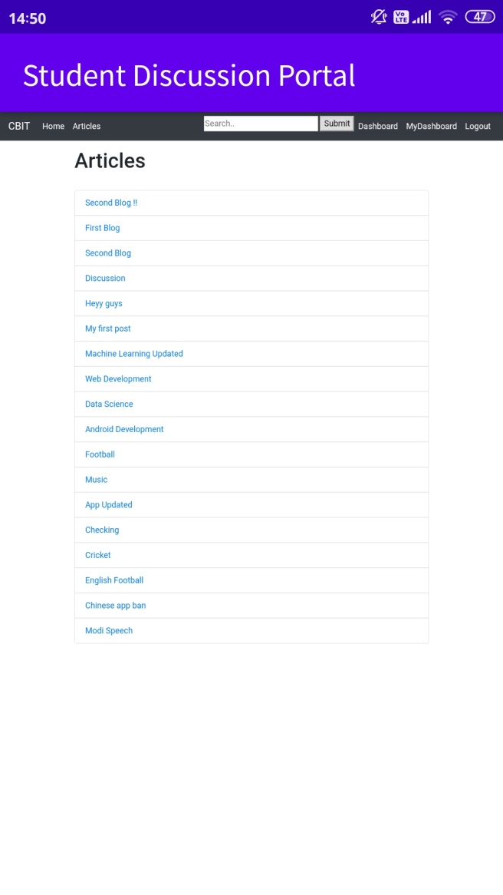

Slide 29
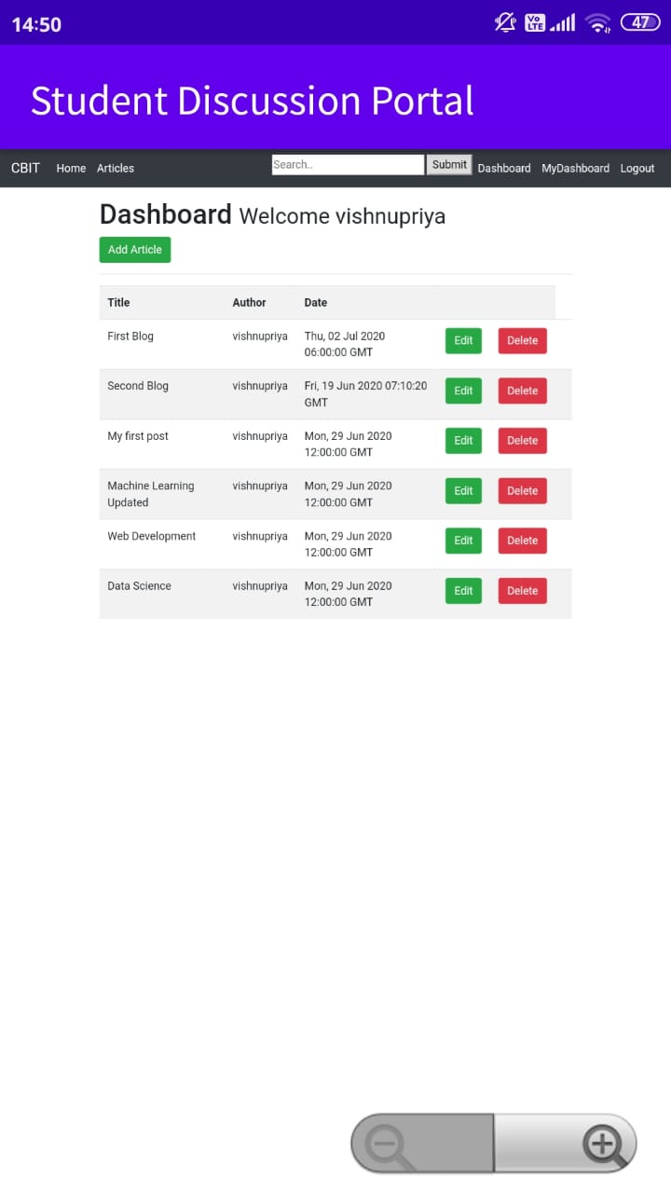

Slide 30
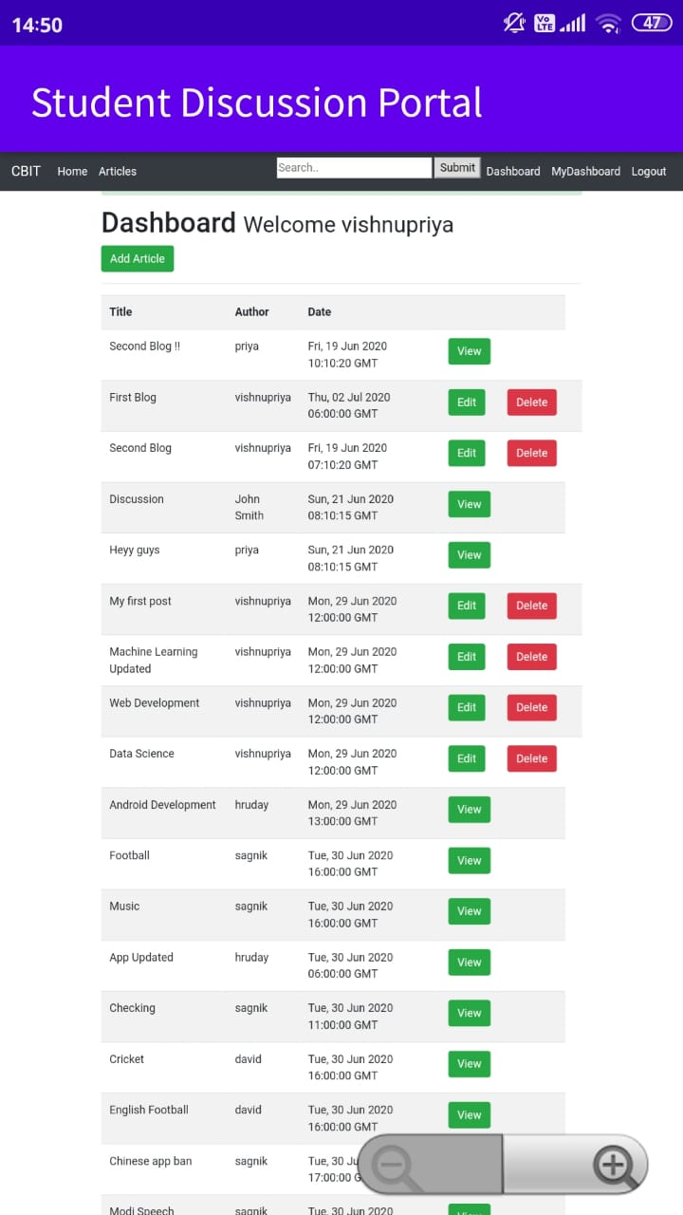

Slide 31
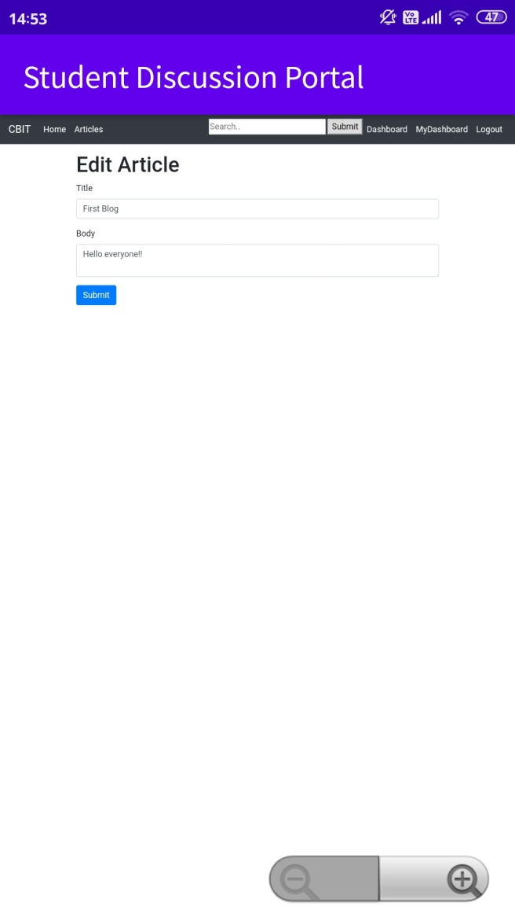

Slide 32
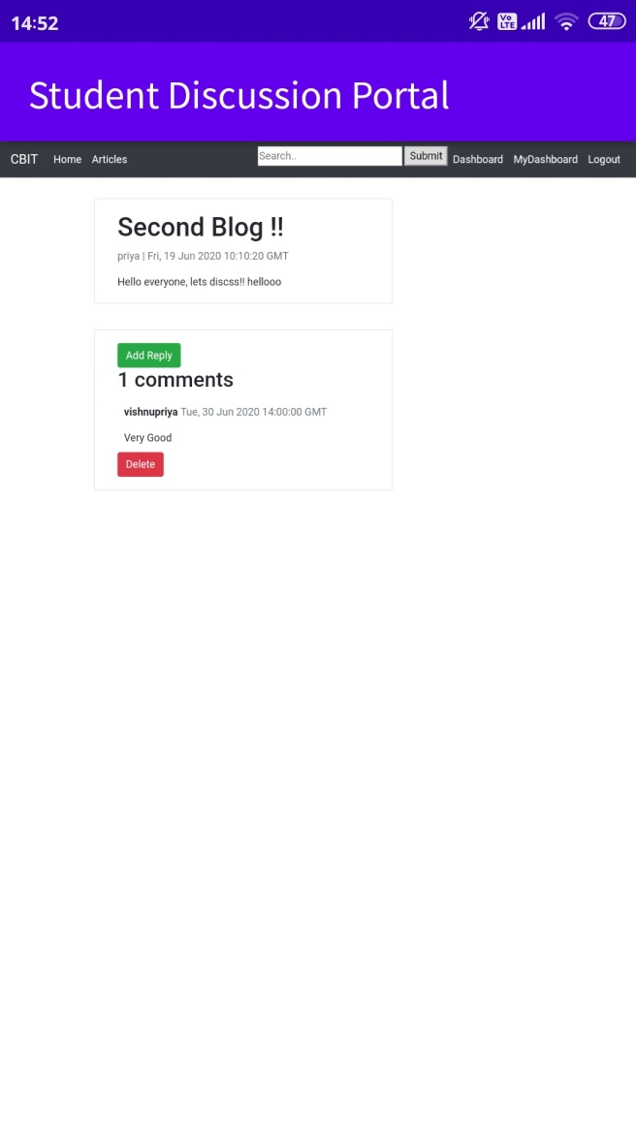

Slide 33
LINKS
http://coscteam9.herokuapp.com/
https://github.com/cbitosc/SkillUp-Team-09

